Slide 1
Prediction Algorithm for Weekly Asthma Admissions
February 2024 Update
Presented By:
Stephen Colegate, Ph.D.
Postdoctoral Research Fellow
stephen.Colegate@cchmc.org

Slide 2
Data Description
Daily number of patients admitted with asthma.
Timespan: January 1, 2016 – June 30, 2023.
Includes admissions from:
All
Avondale
City of Cincinnati
Hamilton County
Eight Catchment Area
Overlap is present between these areas.

Slide 3
Data Description

Slide 4
Data Description
Day | Year | MONTH_NUMBER | MONTH_NAME | MonthDate | AllAdmissions | AvondaleAdmissions | CinciAdmissions | HamiltonCountyAdmissions | EightCatchmentAdmissions
1/1/2016 | 2016 | 1 | January | 1/1/2016 | 3 | 0 | 2 | 2 | 2
1/2/2016 | 2016 | 1 | January | 1/1/2016 | 6 | 0 | 2 | 2 | 6
1/3/2016 | 2016 | 1 | January | 1/1/2016 | 0 | 0 | 0 | 0 | 0
1/4/2016 | 2016 | 1 | January | 1/1/2016 | 2 | 0 | 1 | 0 | 2
1/5/2016 | 2016 | 1 | January | 1/1/2016 | 0 | 0 | 0 | 0 | 0
1/6/2016 | 2016 | 1 | January | 1/1/2016 | 1 | 0 | 1 | 1 | 1
1/7/2016 | 2016 | 1 | January | 1/1/2016 | 0 | 0 | 0 | 0 | 0
1/8/2016 | 2016 | 1 | January | 1/1/2016 | 1 | 0 | 1 | 1 | 1
1/9/2016 | 2016 | 1 | January | 1/1/2016 | 0 | 0 | 0 | 0 | 0
1/10/2016 | 2016 | 1 | January | 1/1/2016 | 2 | 0 | 1 | 1 | 1
1/11/2016 | 2016 | 1 | January | 1/1/2016 | 1 | 0 | 1 | 1 | 1
1/12/2016 | 2016 | 1 | January | 1/1/2016 | 1 | 0 | 1 | 1 | 1
1/13/2016 | 2016 | 1 | January | 1/1/2016 | 3 | 0 | 2 | 2 | 3
1/14/2016 | 2016 | 1 | January | 1/1/2016 | 0 | 0 | 0 | 0 | 0
Focus on the All Admissions column.
Treat # cases weekly.

Slide 5
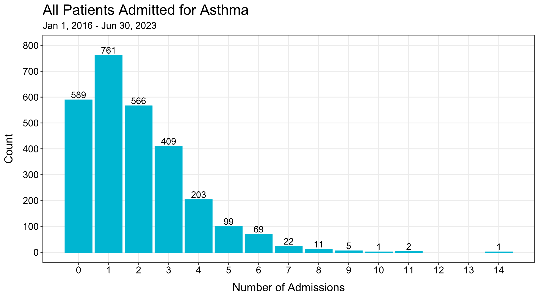

Slide 6
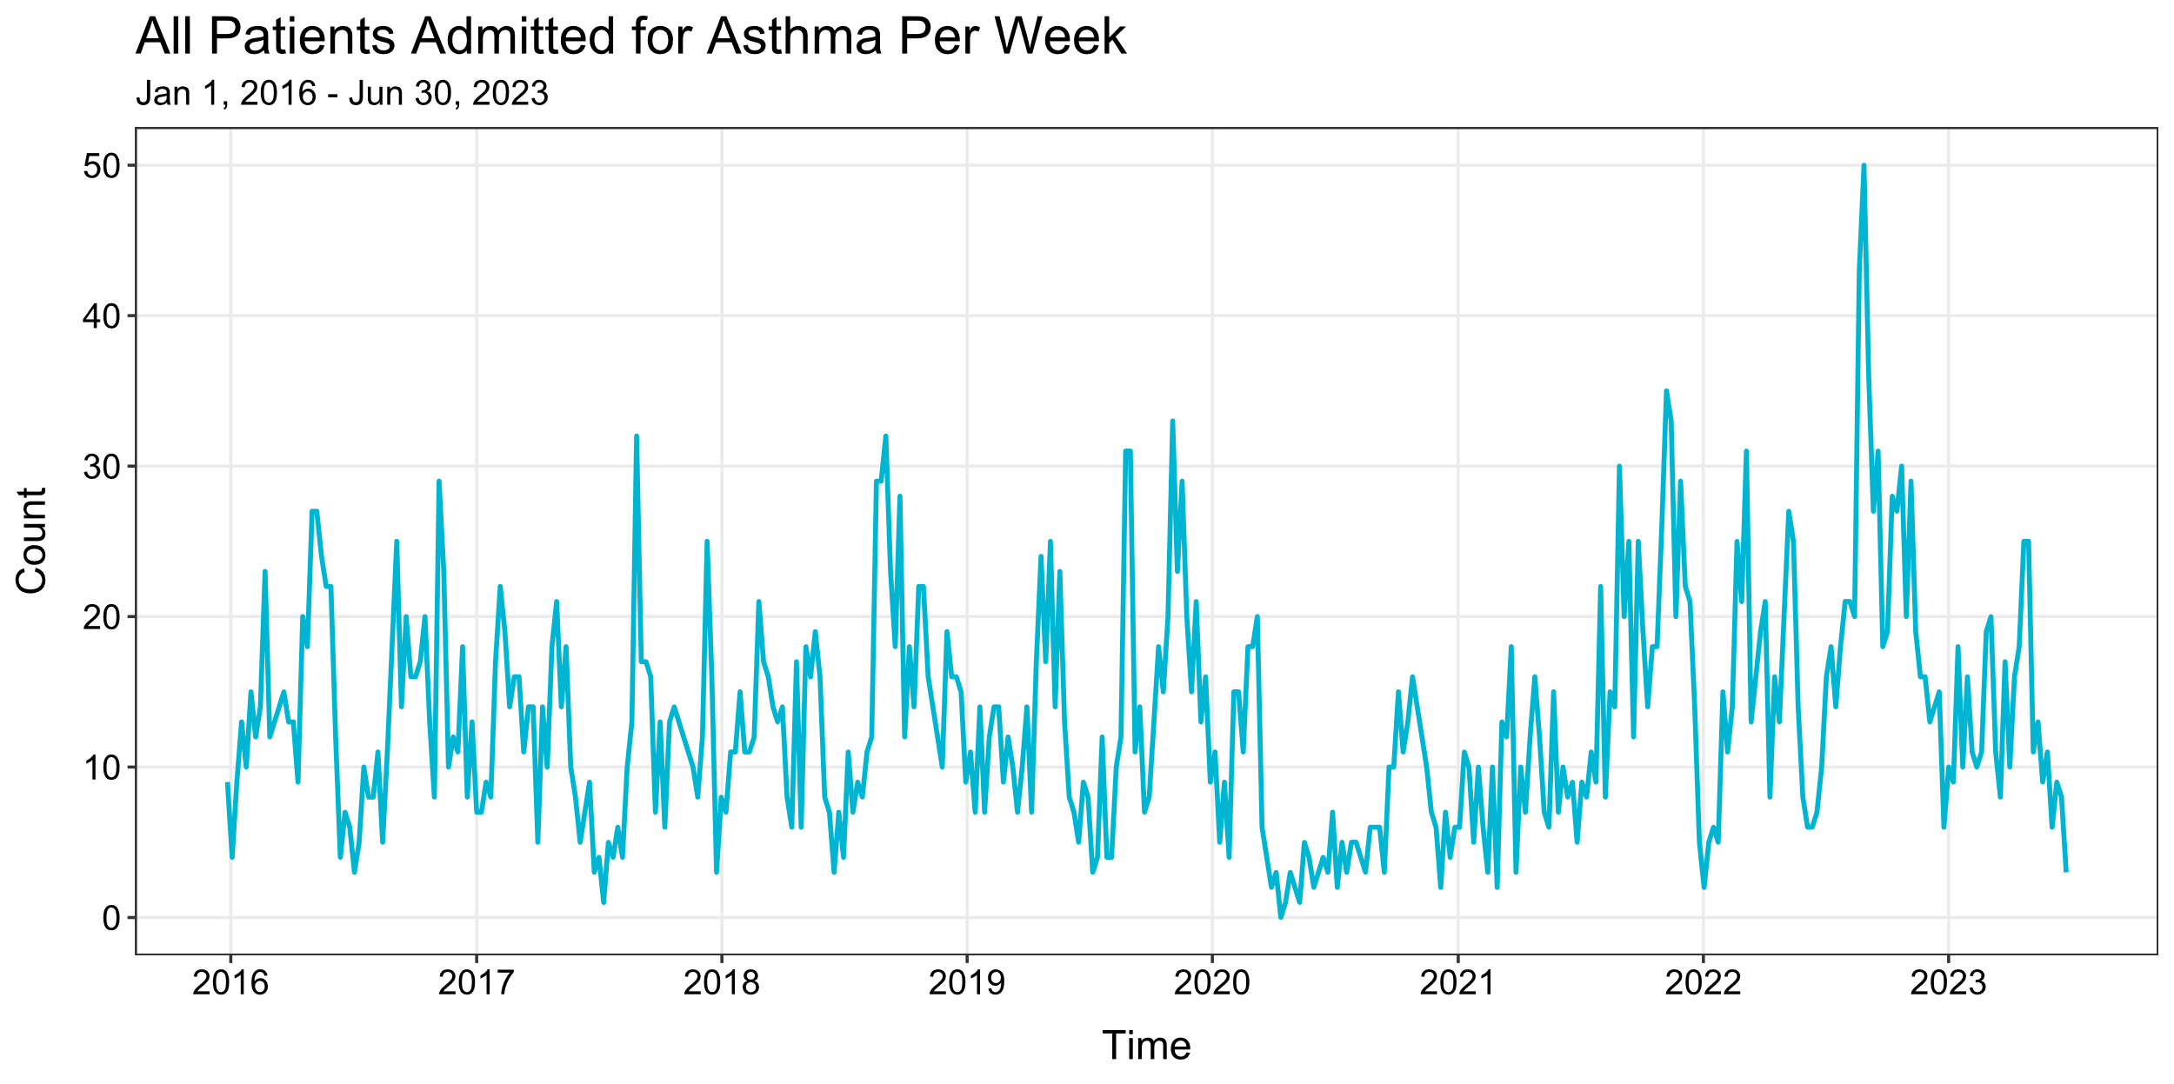

Slide 7
FORECASTING MODEL

Slide 8
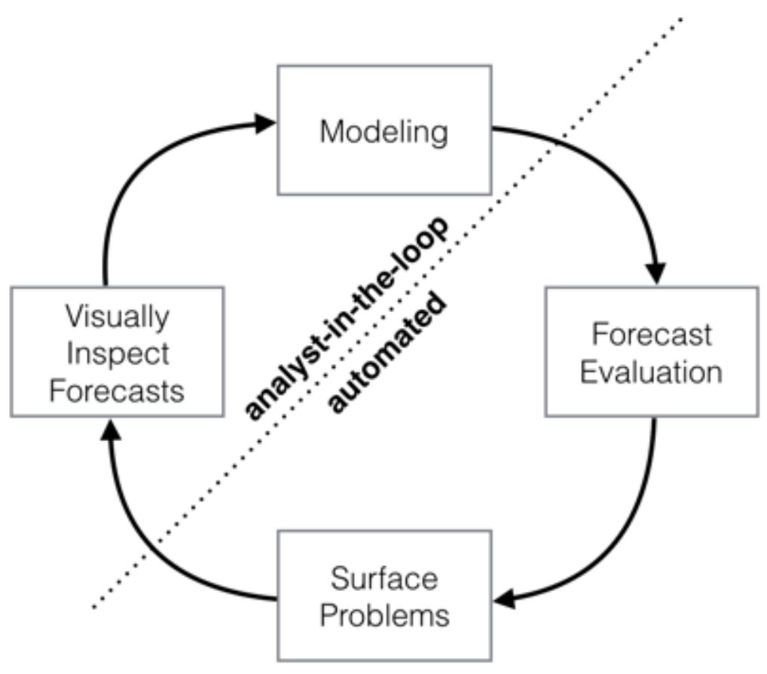
Prophet Model
Challenges associated with producing reliable, high-quality forecasts.
ARIMA model pitfalls.
Must produce forecasts at scale.
Large number of forecasts (possibly without training models).
Forecasts has idiosyncratic features.
Evaluating forecast accuracy over time.
Taylor SJ, Letham B. 2017. Forecasting at scale. PeerJ Preprints 5:e3190v2 https://doi.org/10.7287/peerj.preprints.3190v2.
https://facebook.github.io/prophet/docs/quick_start.html#r-api.

Slide 9
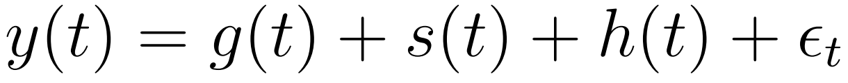
Prophet Model
Prophet model is an open-source decomposable time series model developed by Facebook.
Three main model components:
Trend – non-periodic changes.
Seasonality – period changes (e.g., yearly).
Holiday Effects – effects of holidays occurring on irregular schedules.
Taylor SJ, Letham B. 2017. Forecasting at scale. PeerJ Preprints 5:e3190v2 https://doi.org/10.7287/peerj.preprints.3190v2.
https://facebook.github.io/prophet/docs/quick_start.html#r-api.

Slide 10
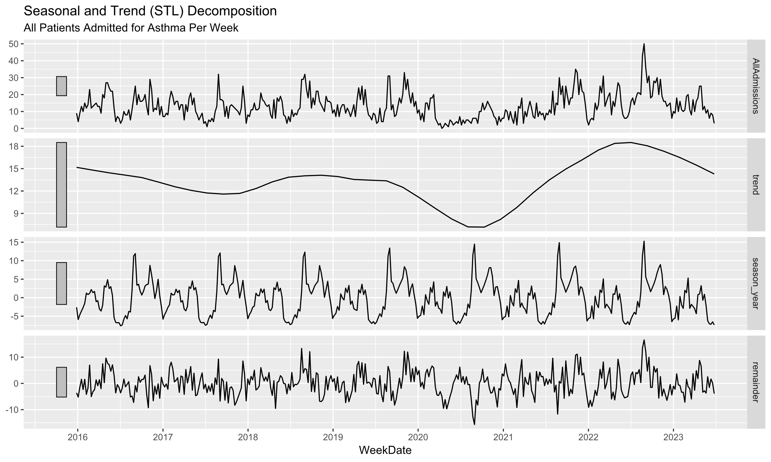

Slide 11
Prophet Model
Can apply our expertise and external knowledge without requiring any understanding of the underlying statistics.
Capacities: Upper cap on total number of weekly asthma admissions.
Changepoints: Known periods of higher/lower admissions can be directly specified.
Holidays and Seasonality: Can directly input dates centers are closed due to holidays or other events.
Smoothing parameters: Adjust historical seasonal variation that is expected in the future.
Taylor SJ, Letham B. 2017. Forecasting at scale. PeerJ Preprints 5:e3190v2 https://doi.org/10.7287/peerj.preprints.3190v2.
https://facebook.github.io/prophet/docs/quick_start.html#r-api.

Slide 12
Model Predictions

Slide 13
Model Predictions
Goal: Predict future weekly all asthma admissions.
Training set: January 1, 2016 – December 31, 2021.
Test set: January 1, 2022 – June 30, 2023.
Use Prophet model to make predictions:
Fit Prophet model to the training set.
Use the model to make “rolling predictions” on the test set.
Classify each week’s prediction.
Compare model predictions to observed admissions to evaluate model performance.

Slide 14
Model Predictions
Rolling prediction – prediction based on a model that is fitted using most recently available data.
Implementation:
Build training data using historical weekly asthma admissions data.
Fit model using the training data.
Predict next week’s asthma admissions from the model.
Observe the actual weekly asthma admissions number.
Include this newest weekly admissions number to the training data.
Repeat steps 2-5 for the following week(s).
Each week, the model is “refitted” to incorporate the newest admissions data before making predictions.

Slide 15
Model Predictions
Classify each week’s admissions number:
NORMAL: 18 or less.
ELEVATED: Between 19 and 30.
HIGH: 30 or more.
Communicate with the clinicians:
Classification – forecasted week (for preparations).
Total number of admissions forecasted.
Upper 95% confidence interval boundary.
15

Slide 16
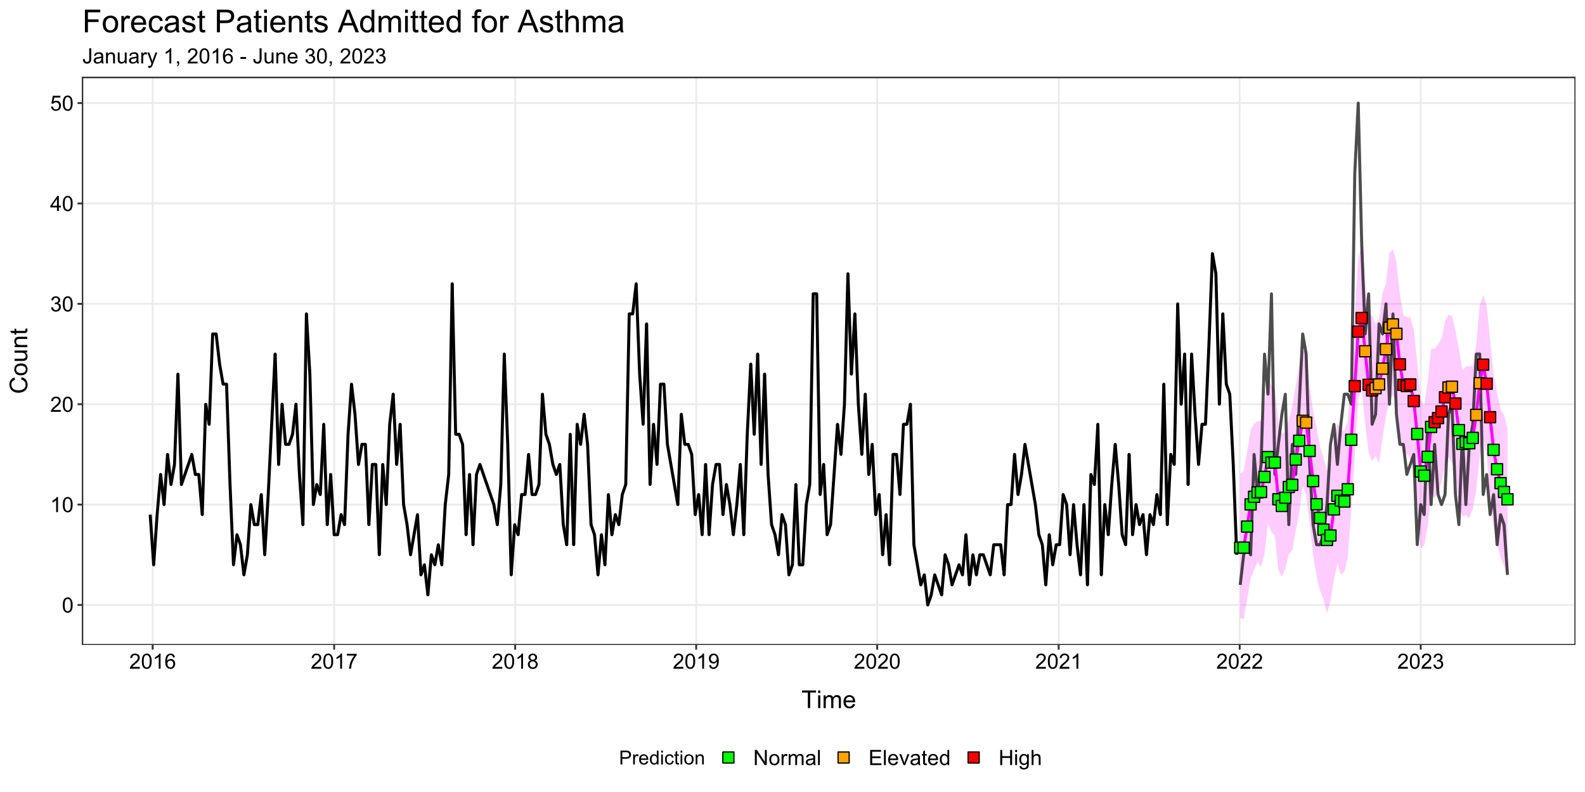
NORMAL | 0-18
ELEVATED | 19-30
HIGH | 31+

Slide 17
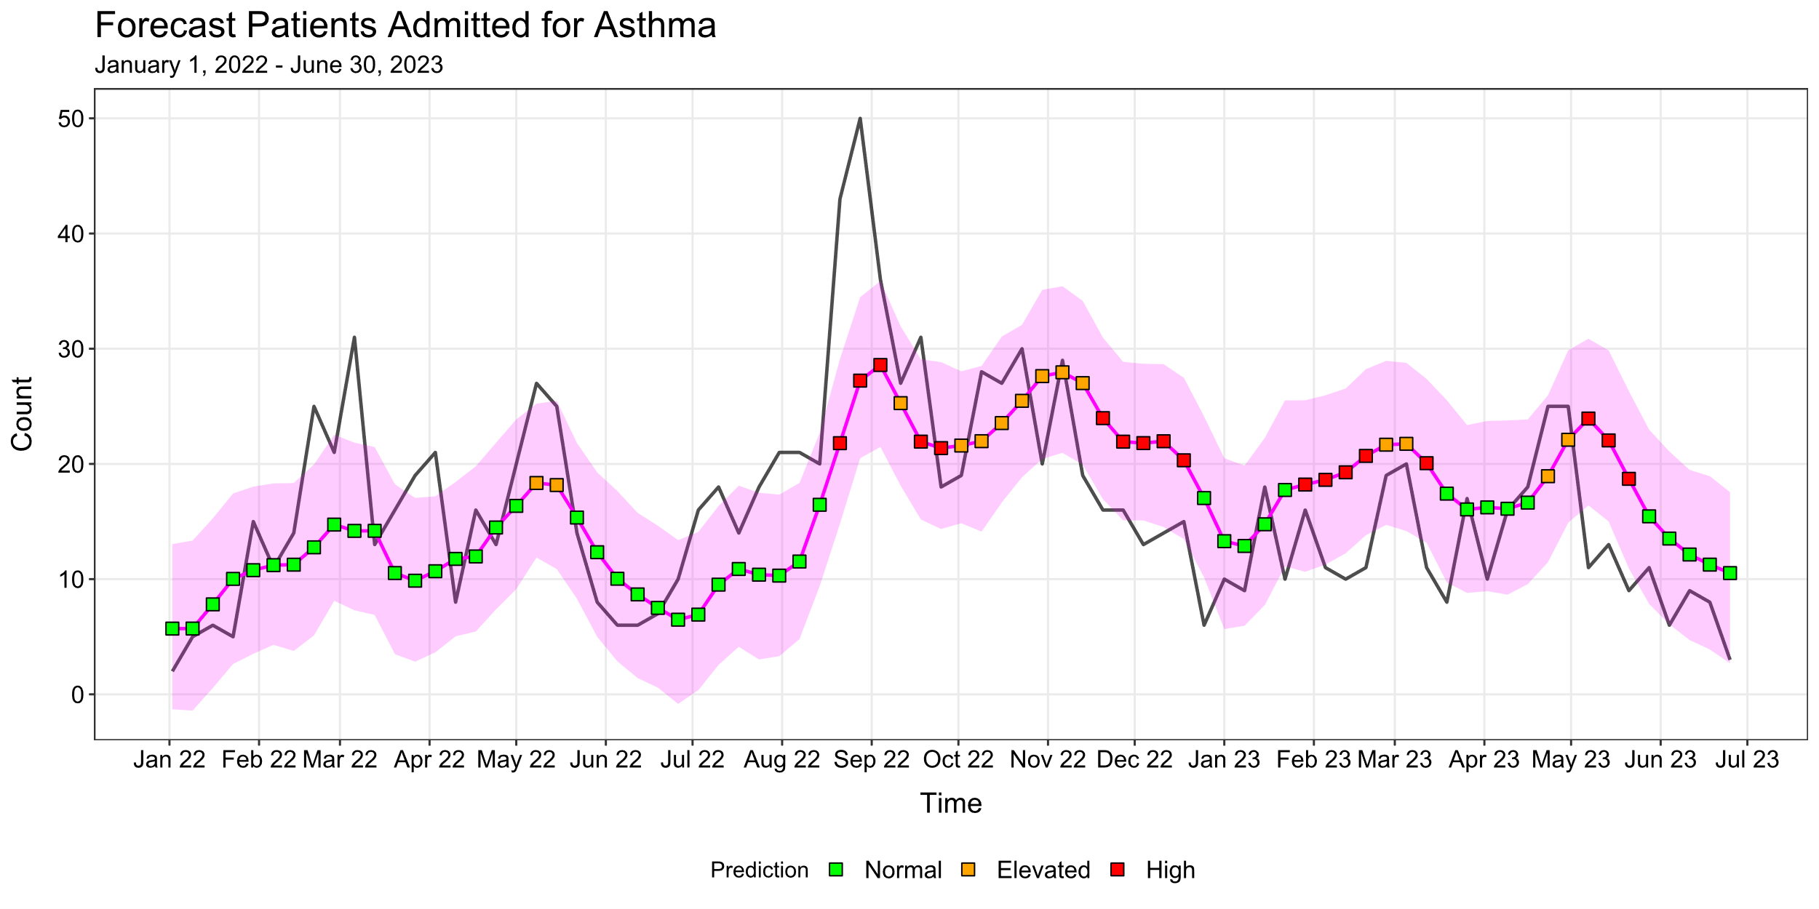
NORMAL | 0-18
ELEVATED | 19-30
HIGH | 31+

Slide 18
Model Predictions
NORMAL | 0-18
ELEVATED | 19-30
HIGH | 31+
Outcome: NORMAL
Prediction | Count
NORMAL | 37
ELEVATED | 0
HIGH | 14
Outcome: ELEVATED
Prediction | Count
NORMAL | 8
ELEVATED | 14
HIGH | 0
Outcome: HIGH
Prediction | Count
NORMAL | 1
ELEVATED | 0
HIGH | 4
Accuracy Rate: 55/78 = 70.5%
False Positive Rate: 14/78 = 17.9%
False Negative Rate: 9/78 = 11.5%

Slide 19
Thoughts & Discussion

Slide 20
Thoughts & Discussion
Classification system:
Clinicians input valuable to selecting appropriate thresholds.
More categories? Labels?
Descriptors of each category?
Calibration of Prophet model.
Ideally overreact then underreact.
Prefer lower false negative rate over false negative rate.
Fix thresholds, then optimize model.
Seasonality adjustments.
Different model for certain parts of the year?
Admissions typically higher when school is in session.
NORMAL | 0-18
ELEVATED | 19-30
HIGH | 31+

Slide 21
Thoughts & Discussion
Additional covariates.
Which variables should be considered?
Will adding variables to model substantially improve prediction accuracy?
Must have ability to obtain/predict data for the forecast.
Comparison of different models.
Try other time series forecasting models.
Need to develop a standard to grade forecasts made for each model.
Do different models handle forecasts differently?
Rolling predictions.
Model is updated prior to achieving forecasts, keeping it up-to-date.
How far back in time should forecasts be kept?

Slide 22
THANK YOU!

